Slide 1


Principles of Microeconomics Session 4: Chicken! (Individual and Market Demand)
Associate Professor Jonathan Tan
j.tan@ntu.edu.sg

Slide 2

Session outline
Individual demand – price and income changes
Different types of goods
Substitutes and complements
Income and substitution effects
Market demand
Hi, I’m Mick, your mascot for today.

Slide 3
Individual demand

Slide 4
Individual Demand
Price Changes
The impact of a change in the price of food can be illustrated using changes in the budget curve -> movements to a new effective indifference curve and bliss point.
For each price change, we can determine how much of the good the individual would purchase given their budget lines and indifference curves
Notes:
4

Slide 5
Getting Cheaper! Effect of a Price Change
Clothing
Assume:
I = $20
P_{C} = $2
P_{F} = $2, $1, $0.50
10
6
A
Each price leads to different amounts of food purchased
5
U₁
D
B
4
U₃
The Price-Consumption Curve traces out the utility maximizing market basket for each price of food
U₂
Food (units
per month)
4
10
12
20
40
Notes:
4

Slide 6
Demand Schedules
By changing prices and showing what the consumer will purchase, we can create a demand schedule and demand curve for the individual
From the previous example:
Demand Schedule for Food
P_{F} | Q_{F}
$2.00 | 4
$1.00 | 12
$0.50 | 20
@u: If my price has increased, do you buy more or less of me?

Slide 7
Individual demand curve – price changes “Change in quantity demanded)
Price
of Food
E
Individual Demand relates
the quantity of a good that
a consumer will buy to the
price of that good.
$2.00
When the price falls:
P_{f}/P_{c} & MRS also fall
G
$1.00
Demand Curve for Food
$.50
E: P_{f}/P_{c} = 2/2 = 1 = MRS
G: P_{f}/P_{c} = 1/2 = .5 = MRS
H:P_{f}/P_{c} = .5/2 = .25 = MRS
H
Food (units
per month)
4
12
20
Notes:
4

Slide 8
Important properties
The level of utility that can be attained changes as we move along the demand curve.
At every point on the demand curve, the consumer is maximizing utility by satisfying the condition that the MRS of food for clothing equals the ratio of the prices of food and clothing, i.e. all bliss points.
Income Changes
The impact of a change in the income can be also illustrated using budget lines and indifference curves.
Changing income, with prices fixed, causes the consumer to change baskets.
Notes:
4

Slide 9
Getting richer! Effects of income changes
Clothing
(units per
month)
Assume: P_{f} = $1, P_{c} = $2
I = $10, $20, $30
An increase in income,
with the prices fixed,
causes consumers to alter
their choice of
market basket.
7
D
U₃
5
U₂
The Income Consumption Curve traces out the utility maximizing market basket for each income level
B
3
A
U₁
Food (units
per month)
4
10
16

Slide 10
Income changes
Income changes
The income-consumption curve traces out the utility-maximizing combinations of food and clothing associated with every income level.
Demand changes
An increase in income shifts the budget line to the right, increasing consumption along the income-consumption curve.
Simultaneously, the increase (decrease) in income shifts the demand curve to the right (left).
Notes:
4

Slide 11
Individual demand curves – income changes “Change in demand”
Price
of
food
An increase in income, from $10 to $20 to $30, with the prices fixed, shifts the consumer’s demand curve to the right as well.
For example, more food is consumed at the same price
E
G
H
$1.00
D₃
@u: What other economic factors will change demand?
D₂
Shift in the Demand
Curve for Food
D₁
Food (units
per month)
4
10
16

Slide 12
Different types of goods

Slide 13
Income consumption curves “normally” slope upwards
Income Changes
When the income-consumption curve has a positive slope:
The quantity demanded increases with income.
The income elasticity of demand is positive.
The good is a normal good.
Notes:
4
Income elasticity of demand = percent change in quantity demanded divided by the percent change in income

Slide 14
But some income consumption curves slope downwards
Income Changes
When the income-consumption curve has a negative slope:
The quantity demanded decreases with income.
The income elasticity of demand is negative.
The good is an inferior good.
For examples; supermarket own brand (Fair Price), tinned meat (corned beef), transport mode, etc…
Notes:
4

Slide 15


An Inferior Good
Steak
(units per
month)
Both hamburger
and steak behave
as a normal good,
between A and B...
Income-Consumption
Curve
C
…but hamburger
becomes an inferior
good when the income
consumption curve
bends backward
between B and C.
10
U₃
5
B
U₂
A
U₁
Hamburger
(units per month)
5
10
20
30

Slide 16
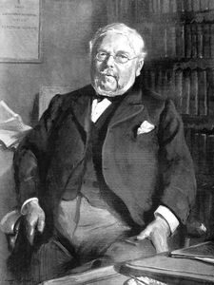
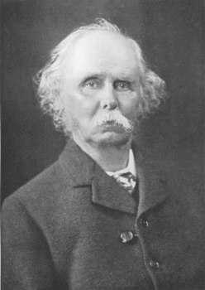
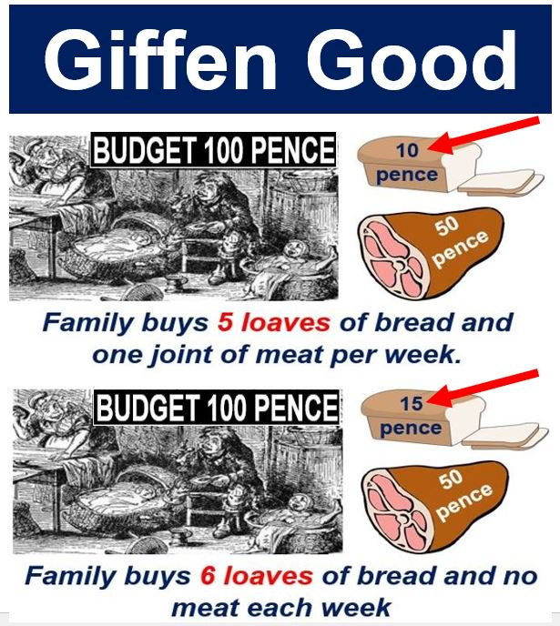
Giffen Goods
A Special Case: The income effect may be large enough to cause the demand curve to slope upward.
This rarely occurs and is of little practical interest.
Sir Alfred Marshall coined the term when he first outlined the Law of Demand in 1895 (Principles of Economics), inspired by the work of Sir Robert Giffen, describing poverty in the Victorian era.
E.g. potatoes, bread, rice…?
Notes:
“As Mr. Giffen has pointed out, a rise in the price of bread makes so large a drain on the resources of the poorer labouring families and raises so much the marginal utility of money to them, that they are forced to curtail their consumption of meat and the more expensive farinaceous foods: and, bread being still the cheapest food which they can get and will take, they consume more, and not less of it (Alfred Marshall, Principles of Economics, 1895, pp. 208-209”

Slide 17
Engel Curves
Engel curves relate the quantity demanded of a good to income.
If the good is a normal good, the Engel curve is upward sloping.
If the good is an inferior good, the Engel curve is downward sloping.
Income
($ per
month)
30
20
Engel curves slope
upward for
normal goods.
10
Food (units
per month)
4
8
12
16
Notes:
4

Slide 18
Engel Curves
Income
($ per
month)
30
Inferior
Engel curves are
backward bending
for inferior goods.
20
Normal
10
Food (units
per month)
4
8
12
16

Slide 19
Substitutes and complements

Slide 20
Product substitutes and complements
Two goods are considered substitutes if an increase (decrease) in the price of one leads to an increase (decrease) in the demand of the other.
Two goods are considered complements if an increase (decrease) in the price of one leads to a decrease (increase) in the demand of the other.
Ex: gasoline and motor oil
Two goods are independent then a change in the price of one good has no effect on the demand of the other
Ex: chicken and airplane tickets
@u: If my price has increased, do you buy more of me or of duck than before?
Notes:
4

Slide 21
Product substitutes and complements
If the price consumption curve is downward-sloping, the two goods are considered substitutes.
If the price consumption curve is upward-sloping, the two goods are considered complements.
Clothing
The Price-Consumption Curve traces out the utility maximizing market basket for each price of food
10
6
A
5
U₁
D
B
4
U₃
U₂
Food (units
per month)
4
12
20
40
Notes:
4

Slide 22
Income and substitution effects

Slide 23
A Change in the Price of a Good….
Suppose P_{F}= $1; P_{C} = $2; I = $ 80
Market Basket | Food P_{F} = $1 | Clothing P_{C} = $2 | Income I = P_{F}F + P_{C}C
A | 0 | 40 | $80
B | 20 | 30 | $80
D | 40 | 20 | $80
E | 60 | 10 | $80
G | 80 | 0 | $80

Slide 24
A Change in the Price of a Good….
Previously, P_{C} = $2; Suppose now, P_{C} = $1; P_{F}= $1; I = $ 80
Before P_{F}/P_{C}=1/2 🡪 After P_{F}/P_{C}=1 🡪 Clothing has become relatively cheaper.
What would you do?
Substitute Food with Clothing 🡪 Go after the cheaper product 🡪 buy more Clothing.
SUBSTITUTION EFFECT

Slide 25
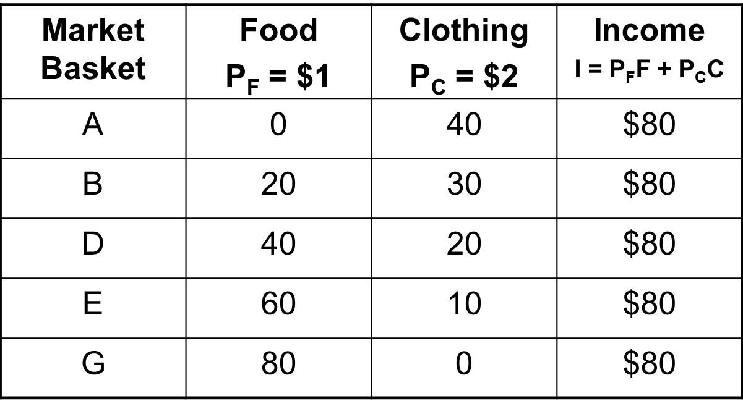
A Change in the Price of a Good….
Suppose now; P_{C} = $1; P_{F}= $1; I = $ 80
P_{C} = $1
$40
$50
If my price has increased, are you better or worse off now?
$60
$70
$80

Slide 26
A Change in the Price of a Good….
You feel “richer” by the amount of money you save when you consumed your original bundle of goods.
I₀ = $ 80 🡪 I₁ = $ 60 🡪 you feel $20 richer!
@u: What would you do then?
Buy more clothing?
Buy more food?
Buy more clothing and food?
This is INCOME EFFECT

Slide 27
Income and Substitution Effects
A change in the price of a good has two effects:
Substitution Effect
Income Effect

Slide 28
Substitution Effect
Relative price of a good changes when price changes
Consumers will tend to buy more of the good that has become relatively cheaper, and less of the good that is relatively more expensive.
@u: During the Great Singapore Sale, all clothes are discounted, but the not food. How would that affect how much you spend on each good?
The substitution effect is the change in the quantity of a good demanded associated with a change in its price, with the level of utility held constant.
When the price decreases, the substitution effect always leads to an increase in the quantity demanded of the good.

Slide 29
Income Effect
Consumers experience an increase in real purchasing power when the price of one good falls.
@u: can you buy more food if the prices of all clothes are suddenly halved?
The income effect is the change in the quantity of a good demanded brought about by the increase in real purchasing power, with the price of the item held constant.
When a person’s income increases, the quantity demanded for the product may increase or decrease.

Slide 30
Income and Substitution Effects: Normal Good
Clothing
(units per
month)
When the price of food falls, consumption increases by F₁F₂ as the consumer moves from A to B.
First, when we evaluate the substitution effect, we need to focus on the impact of the change in the relative price, keeping the ‘real’ income constant.
Next, we can subtract the substitution effect from the total effect to get the income effect.
R
The substitution effect,F₁E,
(from point A to D), changes the
relative prices but keeps real income
(satisfaction) constant.
C₁
A
The income effect, EF₂,
( from D to B) keeps relative
prices constant but
increases purchasing power.
D
B
C₂
U₂
Substitution
Effect
U₁
Food (units
per month)
O
F₁
E
S
F₂
T
Total Effect
Income Effect

Slide 31
Objective: Decompose the Total Effect
Clothing
(units per
month)
When the price of food falls, consumption increases by F₁F₂ as the consumer moves from A to B.
R
C₁
A
B
C₂
U₂
U₁
Food (units
per month)
O
F₁
S
F₂
T
Total Effect

Slide 32
Substitution Effect
First, when we evaluate the substitution effect, we need to focus on the impact of the change in the relative price, keeping the ‘real’ income constant.
The substitution effect,F₁E,
(from point A to D), changes the
relative prices but keeps real income
(satisfaction) constant.
Clothing
(units per
month)
R
C₁
A
D
C₂
U₂
Substitution
Effect
U₁
Food (units
per month)
O
F₁
E
S
F₂
T
Total Effect

Slide 33
Income Effect
Next, we can subtract the substitution effect from the total effect to get the income effect.
The income effect, EF₂,
( from D to B) keeps relative prices constant but increases purchasing power.
Clothing
(units per
month)
R
C₁
D
B
C₂
U₂
U₁
Food (units
per month)
O
E
F₂
T
Income Effect

Slide 34
Income Effect + Substitution Effect = Total Effect
NB: In this example the income effect does not result in a change in the consumption level of clothes, because the substitution effect fully accounts for this. However, this is not generally true for all cases – there are cases where income effects also account for some of the change in consumption of the other good for which price is constant.
Clothing
(units per
month)
R
C₁
A
D
B
C₂
U₂
Substitution
Effect
U₁
Food (units
per month)
O
F₁
E
S
F₂
T
Total Effect
Income Effect

Slide 35
Even with inferior goods, the income effect is rarely large enough to outweigh the substitution effect
Clothing
(units per
month)
Since food is an
inferior good, the
income effect is
negative.
However,
the substitution effect
is larger than the
income effect.
R
A
B
U₂
D
Substitution
Effect
U₁
O
F₁
F₂
S
T
Food (units
per month)
E
Total Effect
Income Effect

Slide 36
Market demand

Slide 37
Market (or Aggregate) Demand
A curve that relates the quantity of a good that all consumers in a market buy to the price of that good.
The sum of all the individual demand curves in the market
Price | A | B | C | Market Demand
1 | 6 | 10 | 16 | 32
2 | 4 | 8 | 13 | 25
3 | 2 | 6 | 10 | 18
4 | 0 | 4 | 7 | 11
5 | 0 | 2 | 4 | 6

Slide 38
Summing to Obtain a Market Demand Curve
Price
5
The market demand
curve is obtained by
summing the consumer’s
demand curves
4
3
Market Demand
2
1
D_{A}
D_{B}
D_{C}
0
5
10
15
20
25
30
Quantity

Slide 39
Market Demand
@u: Tourism has bounced back, will SG buy more or less of me than in 2020?
From this analysis one can see two important points
The market demand will shift to the right as more consumers enter the market.
Factors that influence individual consumer demand will also affect aggregate market demand.
E.g. increasing household size, population increase, expectations, consumer preferences

Slide 40
The Aggregate Demand For Wheat
Price
Total world demand is
the horizontal sum of the
domestic demand AB and
export demand CD.
18
A
16
Above C, export demand is zero so domestic demand = total demand = AE segment
10
C
E
Total Demand
Export
Demand
Domestic
Demand
D
B
F
0
Wheat

Slide 41
Recall… Example – 1) MRS = slope of budget line
U = 2X^{0.5}Y^{0.5}
P_{X} = 1, P_{Y} = 2, I = 80
MRS = MU_{X}/MU_{Y}
MU_{X} = dU/dX = (2*0.5)X^{(0.5-1)}Y^{0.5} = X^{-0.5}Y^{0.5} = Y^{0.5}/X^{0.5}
MU_{Y} = dU/dY = (2*0.5)X^{0.5}Y^{(0.5-1)} = X^{0.5}Y^{-0.5} = X^{0.5}/Y^{0.5}
MU_{X}/MU_{Y} = Y/X
MRS = P_{X}/P_{Y} = ½
P_{X}/P_{Y} = ½
Y/X = ½
Y = X/2
=> buy ½ as much Y as X

Slide 42
Recall… Example – 2) optimal consumption bundle Now: Work out individual demand function
I = P_{x}X + P_{y}Y
Keep constant income (I) and price of Y (P_{y}), leave P_{X} free- @u: why?
80 = P_{x}X + 2Y
Substitute Y with X/2, express X in terms of the other terms
80 = P_{x}X + 2(X/2)
80 = P_{x}X + X
80 = X(P_{x} + 1)
X = 80/(P_{x} + 1)
As P_{x} increases, X decreases
@u: Aggregate demand: what if there are 100 of such consumers in the market?

Slide 43
Recall… Example – 2) optimal consumption bundle Now: Work out Engel curve
I = P_{x}X + P_{y}Y
keep constant P_{X} and P_{y}, leave I free, - @u: why?
I = 1X + 2Y
Substitute Y with X/2, express X in terms of the other terms
I = X + 2(X/2)
I = X + X
I = 2X
As I increases, X increases

